Slide 1


Together for the New Style of IT
HP Enterprise Technology & Solutions Summit 2015
Dublin, Ireland June 15-19
#HPETSS

Slide 2
iMC customization
How to make iMC fit your custom needs
Fabien GIRAUD / June 18, 2015

Slide 3
Confidential Disclosure Agreement
The information contained in this presentation is proprietary to Hewlett-Packard Company and is offered in confidence, subject to the terms and conditions of a binding Confidential Disclosure Agreement (CDA)
HP requires customers and partners to have signed a CDA in order to view this training
The information contained in this training is HP confidential
This presentation is NOT to be used as a ‘leave behind’ for customers and information may only be shared verbally with HP-external customers under NDA
This presentation may be shared with HP Channel partners under NDA in hard-copy or electronic format for internal training purposes only
Do not remove any classification labels, warnings or disclaimers on any slide or modify this presentation to change the classification level.
Do not remove this slide from the presentation
HP does not warrant or represent that it will introduce any product to which the information relates
The information contained herein is subject to change without notice
HP makes no warranties regarding the accuracy of this information
The only warranties for HP products and services are set forth in the express warranty statements accompanying such products and services
Nothing herein should be construed as constituting an additional warranty
HP shall not be liable for technical or editorial errors or omissions contained herein
Strict adherence to the HP standards of business conduct regarding this classification level is critical.
HP Confidential - provided to HP employees and HP Partners for internal training purposes only
Notes:
Some of the information in this session may be confidential. If you are not an HP employee, you must have a confidential disclosure agreement on file with HP to participate in the remainder of this session. Partners and contract trainers that have these agreements in place are welcome to attend.
Next slide, please.

Slide 4
Abastract
Session to show how deep you can go in iMC customization
AIMS
What do you have out-of-the-box ?
Why do you need more ?
What can we cusomize and how ?

Slide 5
Introduction
iMC out of the box
In 90% of the case features embedded by default in iMC are enough:
More than 6900 supported devices
Status / Alarm monitoring
Main performance indexes monitoring (CPU usage, Memory usage, bandwidth …)
Config management (backup, restore, templates, compliance, VLAN, ACL …) for main vendor devices
Virtual Environment monitoring
Advanced features with additional modules:
Netflow / Sflow monitoring with NTA
Wireless management with WSM
NAC / NAP / BYOD with UAM (and EAD)
Application Monitoring with APM
…
Notes:
In this very simple example, this can take hours (even perhaps days if level 2 needs to connect on each switch to find where the user is connected)

Slide 6
Introduction
Why do you need more ?
In some cases, real specific needs:
Specific / exotic device to monitor
Specific performance data to monitor
Needs to integrate with other tools
Needs to have a quick access to specific data
…

Slide 7
Introduction
What can you do in iMC ?
The answer is … ANYTHING ☺
Customize home page, dashboard, topologies …
Add new device model to be monitored through SNMP – add new performance data to catch
Add new device panel
Add configuration templates
Add custom actions, batch operations
Customize alarm management (add / modify SNMP traps – Syslog messages, add automatic action …)
Add configuration management and / or vlan management for new devices
Add new report templates
Integrate with other tools / scripts

Slide 8
Introduction
How ?
For many of the previous points: only need iMC base Platform
FCAPS
Fault
Configuration
Accounting
Performance
Security
IMC Platform
Alarms
Syslog & Trap Mgr
Intelligent Configuration Center
Compliance Center
VLAN & ACL Manager
Network Assets
Performance
Mgmt
Virtual Network Mgmt
Security Control Center
1 / 2 / 3 / 4 / 5 / 6 / 7
Extended API
9
Add-On Modules
IPSec VPN Mgr
MPLS VPN Mgr
Wireless Services Mgr
QoS Mgr
Branch Intelli. Mgmt System
User Behavior Analyzer
Service Oper
Mgmt
Network Traffic Analyzer
App Perform. Manager
User Access Manager
Endpoint Admission Defense
VAN ConnectManager
Remote Site Manager
VAN Resource Automate Manager
VAN Fabric Manager
Intelligent Analysis Reporter
vMon
Service Health Manager
TACACS+ Authent Manager
8
UC Health
Manager
VAN SDN Manager
Notes:
For point 1, 2, 3, 4, 5, 6 and 7 we only need base platform
For point 8 and 9 we need some additional modules

Slide 9
AGENDA
Customizing UI (customization for Dummies)
Home Page - Favorites
Custom Topologies
Dashboard and Display Tilling
Customize alarm management and Actions (basic customization)
SNMP traps / Syslog messages
Automatic Actions
Adding new device SNMP support and monitoring (advanced customization)
New device model
New performance monitoring
New device panel
Add configuration management and actions (expert customization)
Configuration management
New action
New batch operations
Add report templates (guru customization)
Using iAR
Importing the template
Integrate with third application (super guru customization)
eAPI documentation
eAPI example
Notes:
If time, show the event correlation (root cause)

Slide 10
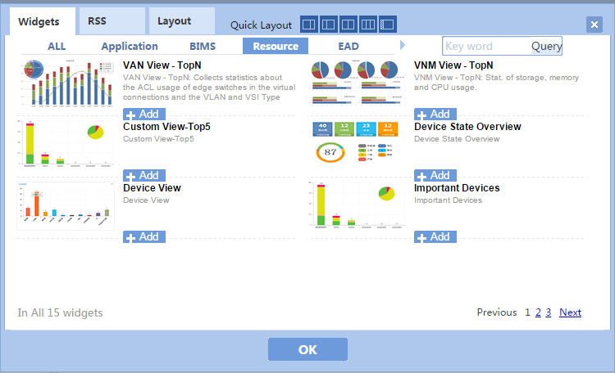
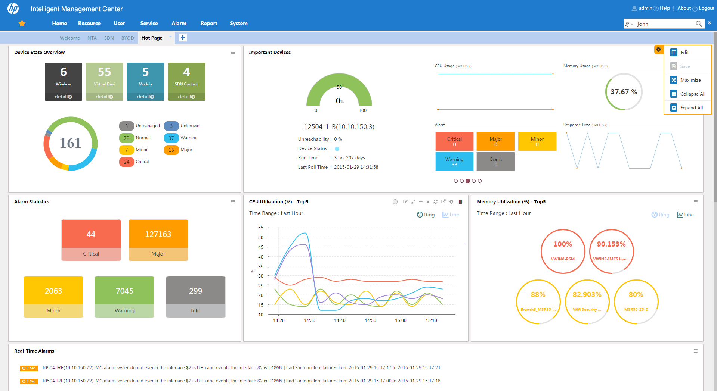
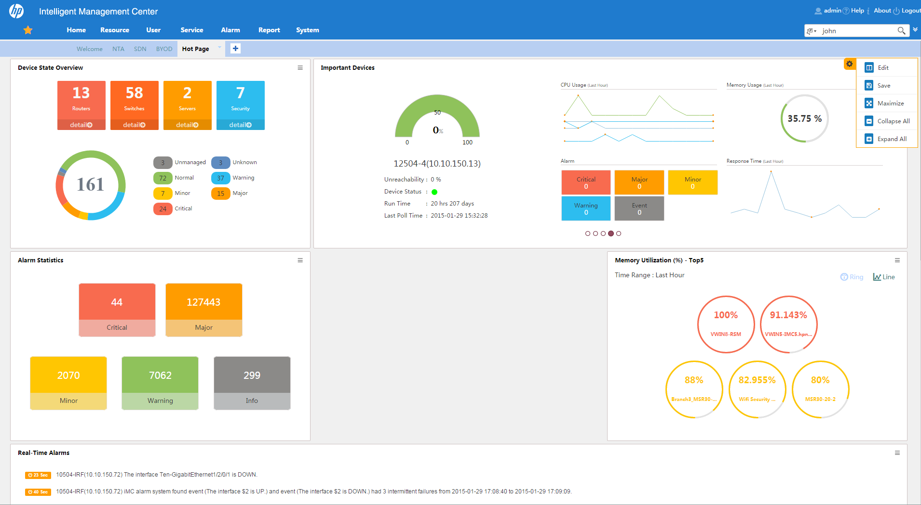
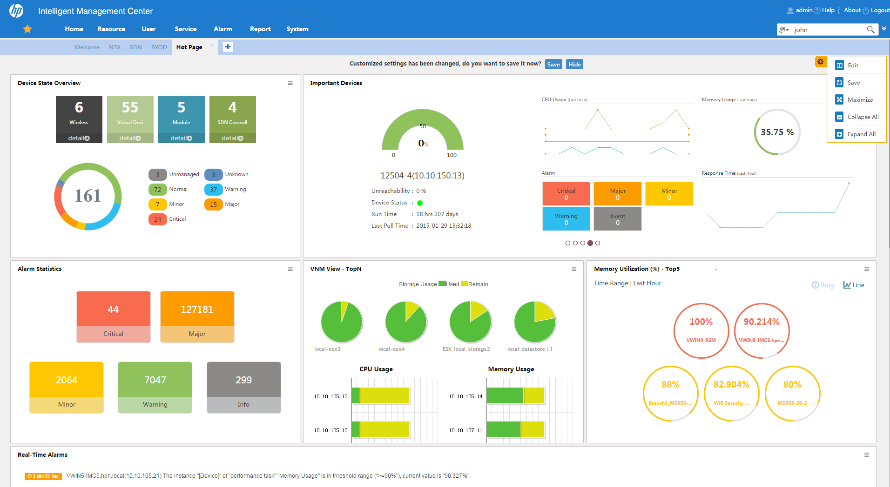
Customizing UI
Playing with Home Page
Customizable HomePage with widgets → Focus on your area of interest.
Add / Remove tabs

Slide 11
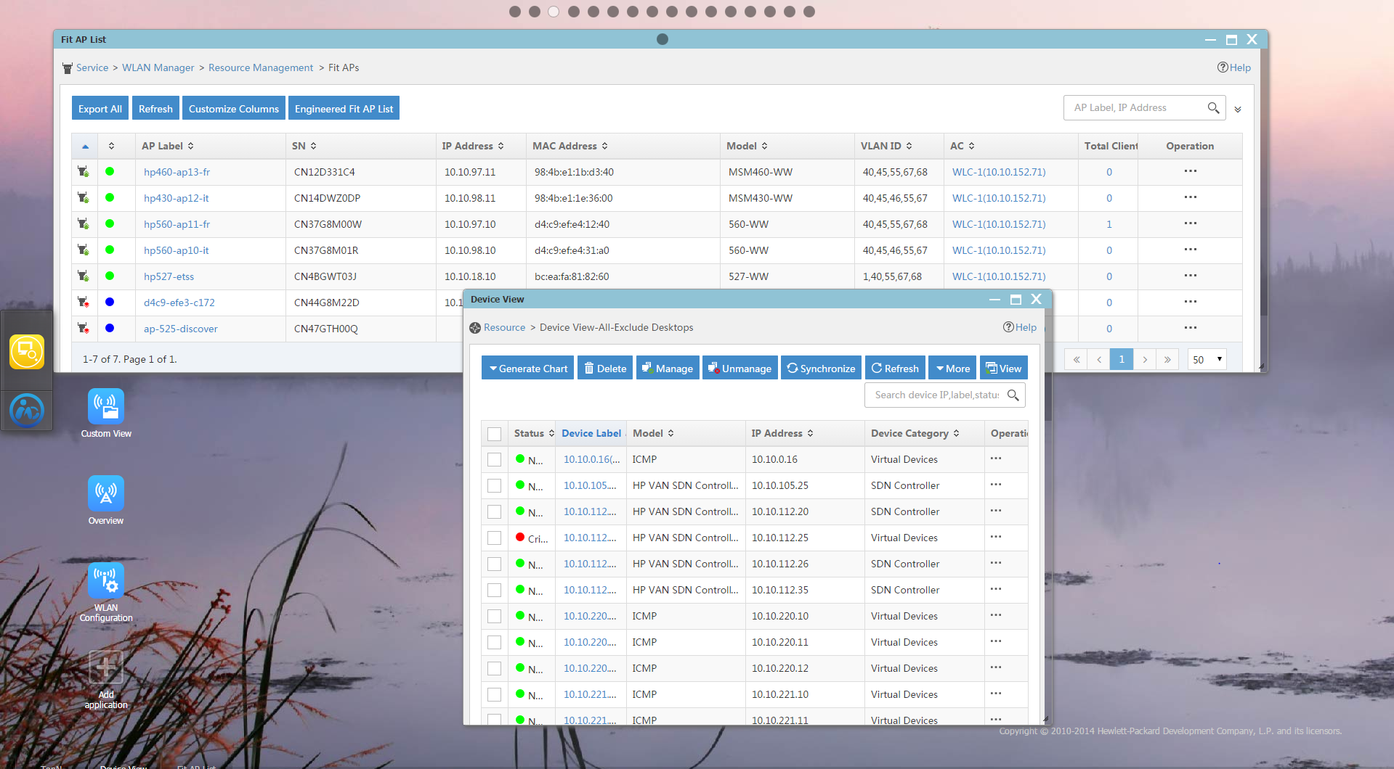
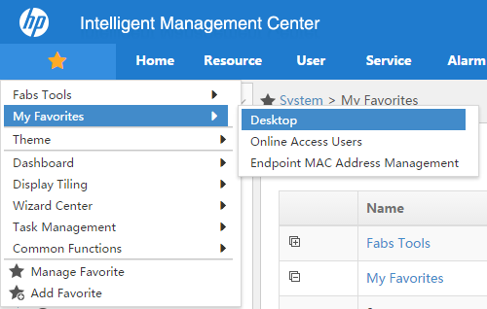
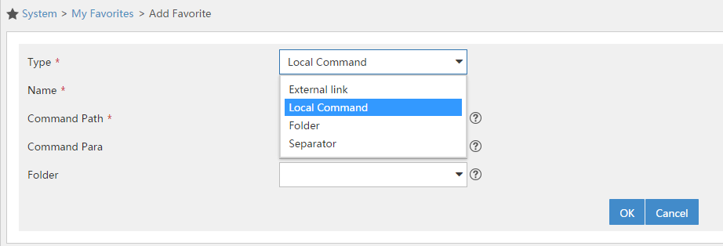
Customizing UI
Using Favorites
Possibility to add direct access to URL or action

Slide 12
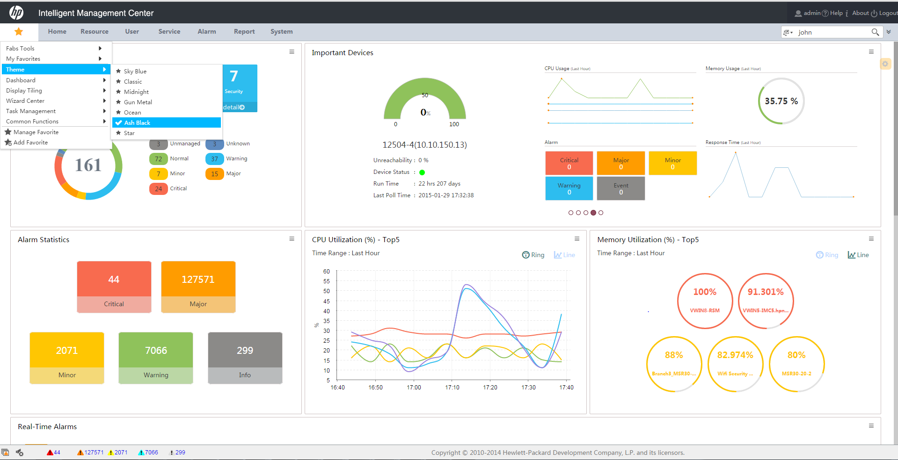
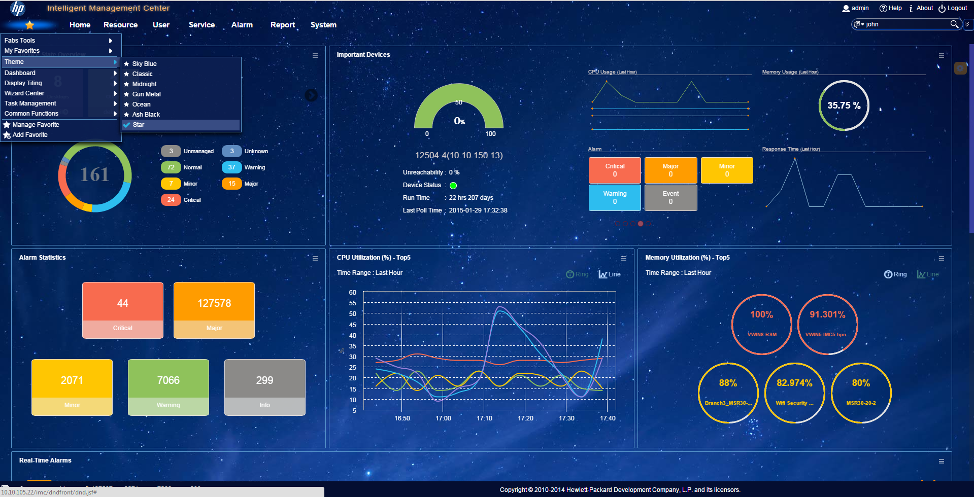
Customizing UI
Change the theme
Different thems are available … Choose the best one !

Slide 13
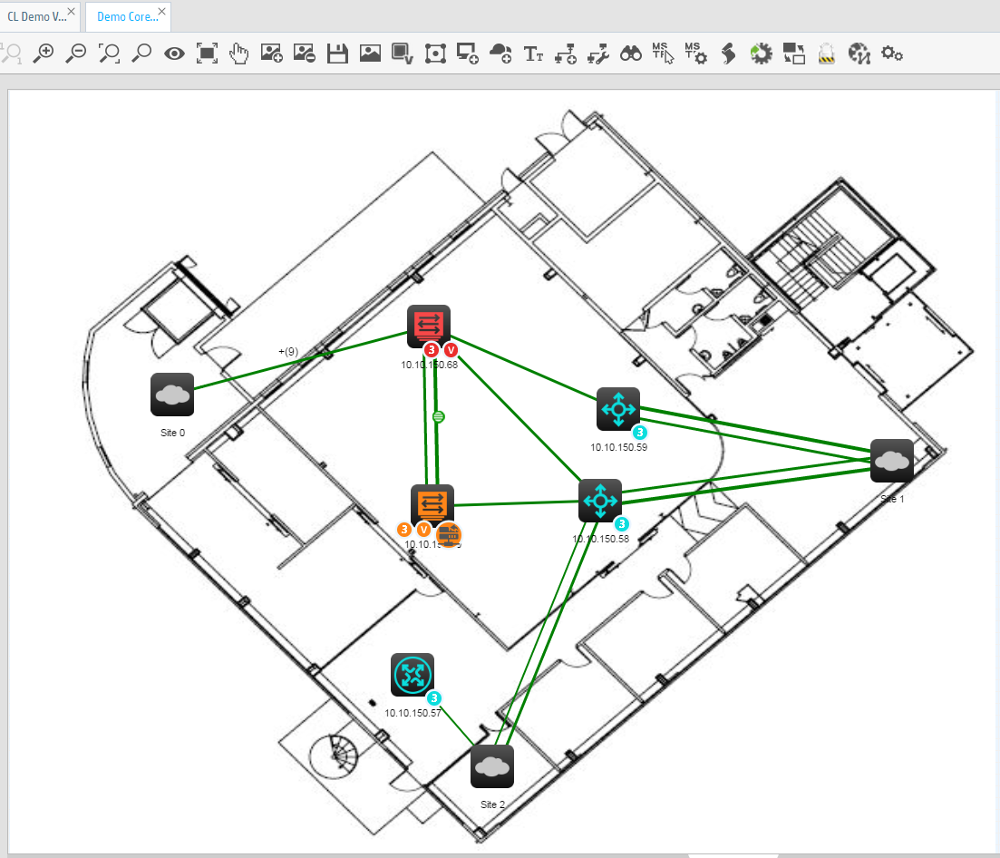
Customizing UI
Custom Topologies
Using Custom Views: automatically add specific devices in a topology, organize the devices on the map, add a background …

Slide 14
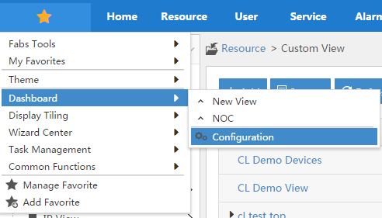
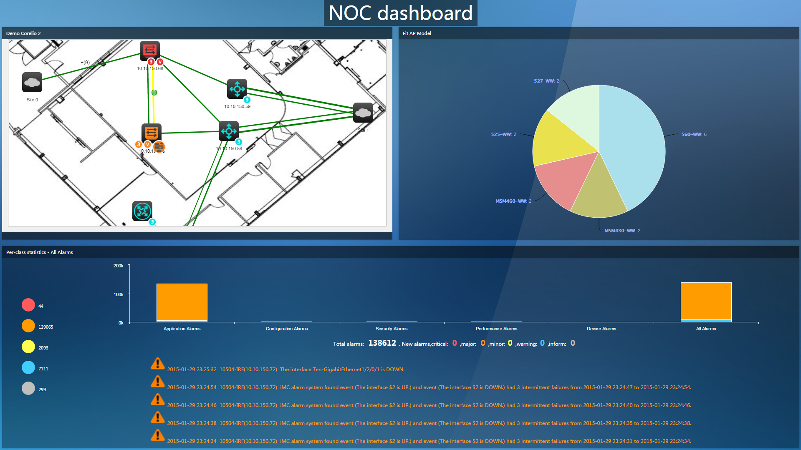
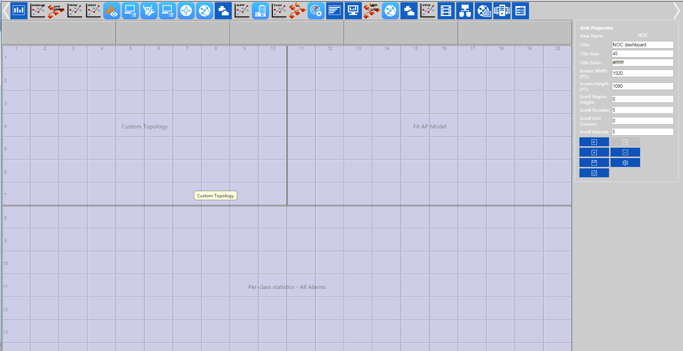
Customizing UI
Dashboard and Display Tiling
Dashboard: usefull to display on a big screen in a NOC room for example
Configure (widgets, size, spaces …)
Result

Slide 15
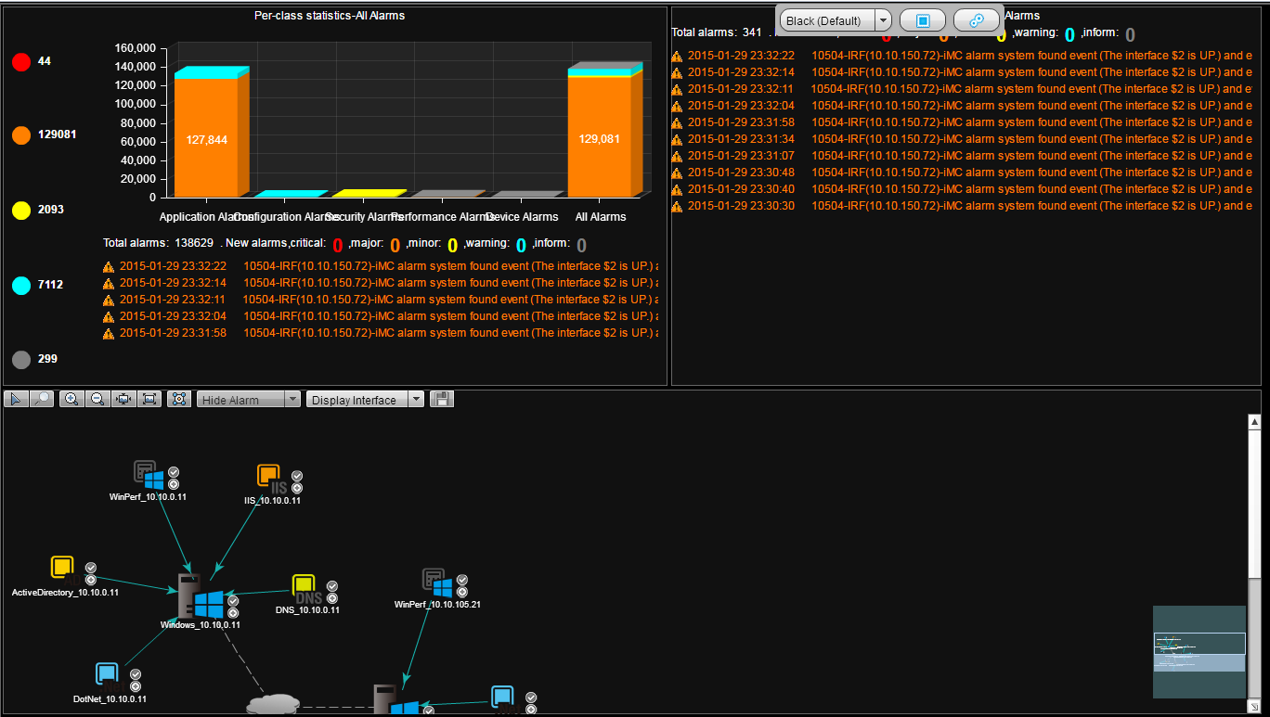
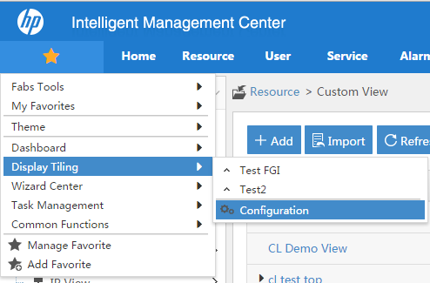
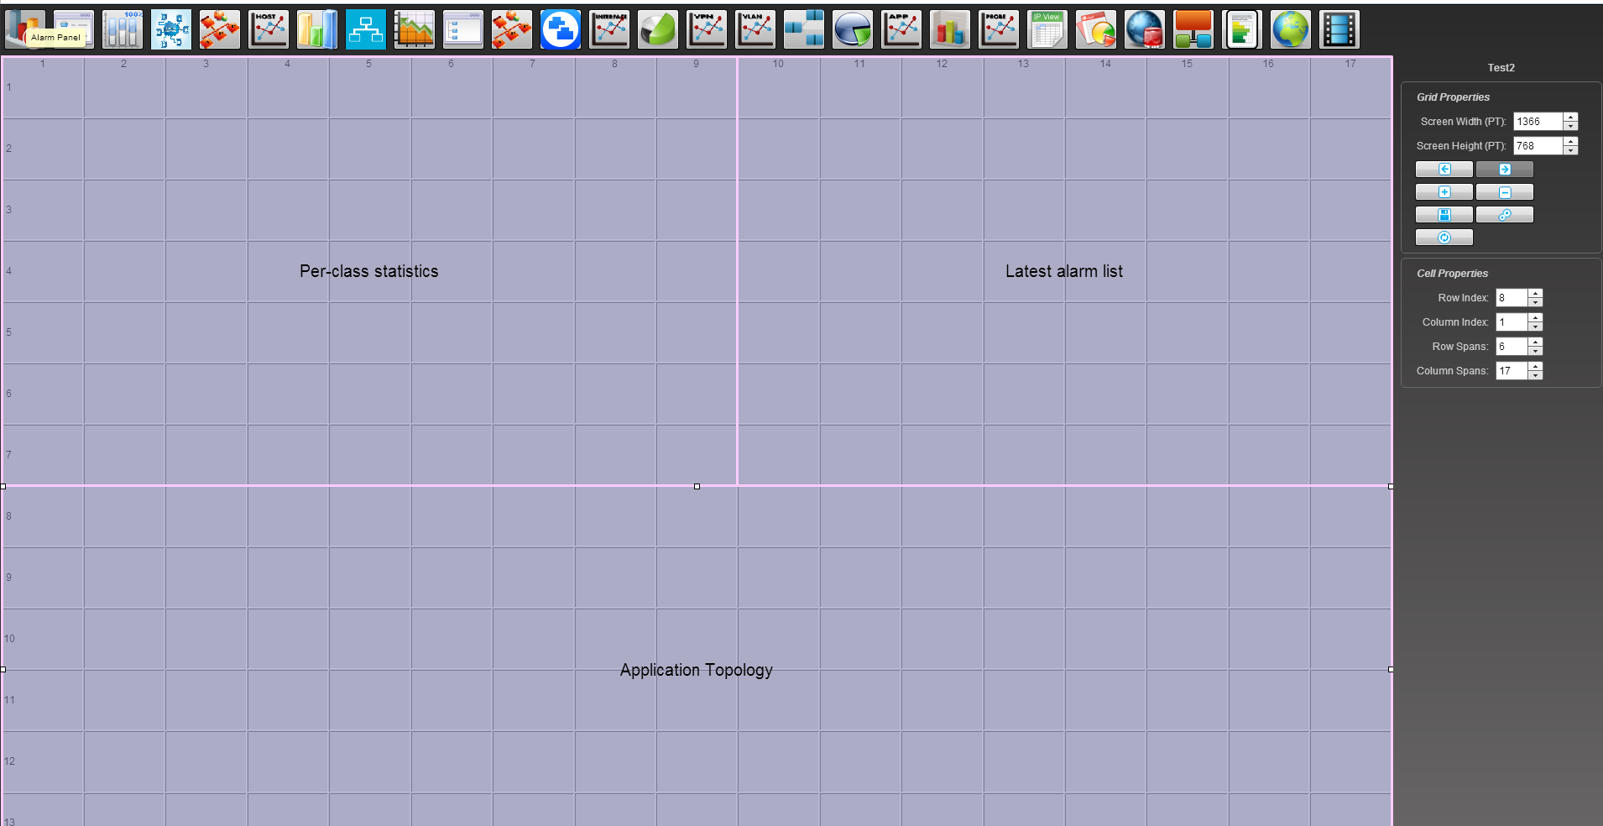
Customizing UI
Dashboard and Display Tiling
We can also use Display Tiling

Slide 16
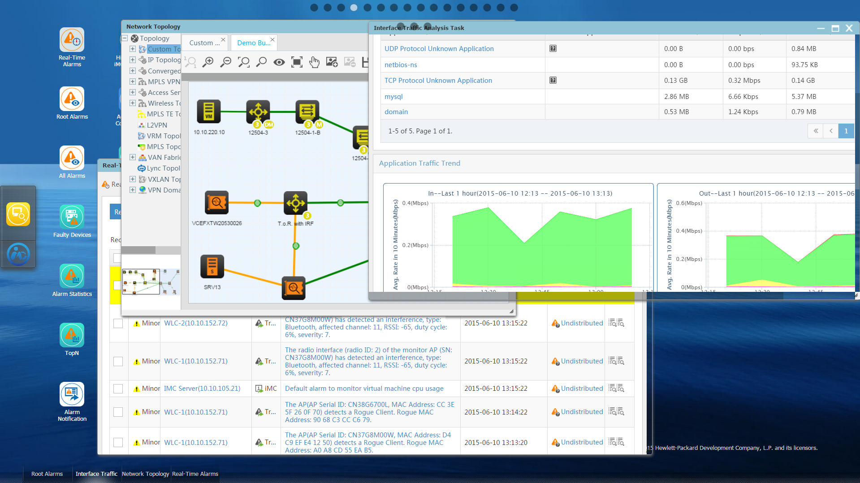
Customizing UI
Desktop UI (Available Q4FY15)
Customize your own interface with multiple applications in different « Virtual » desktops

Slide 17
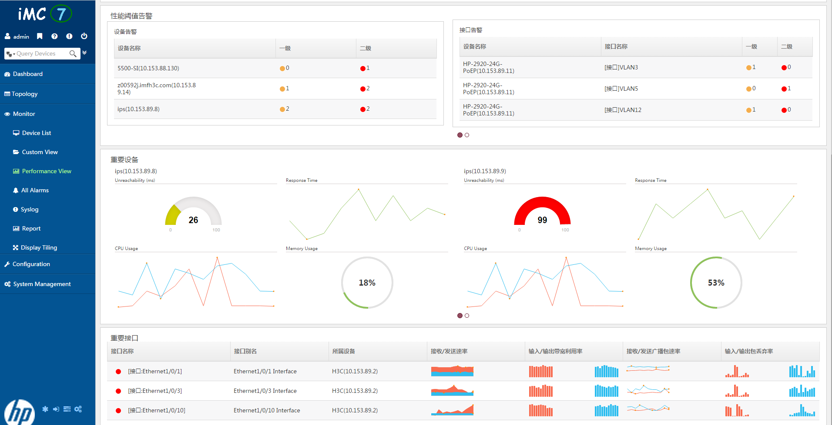
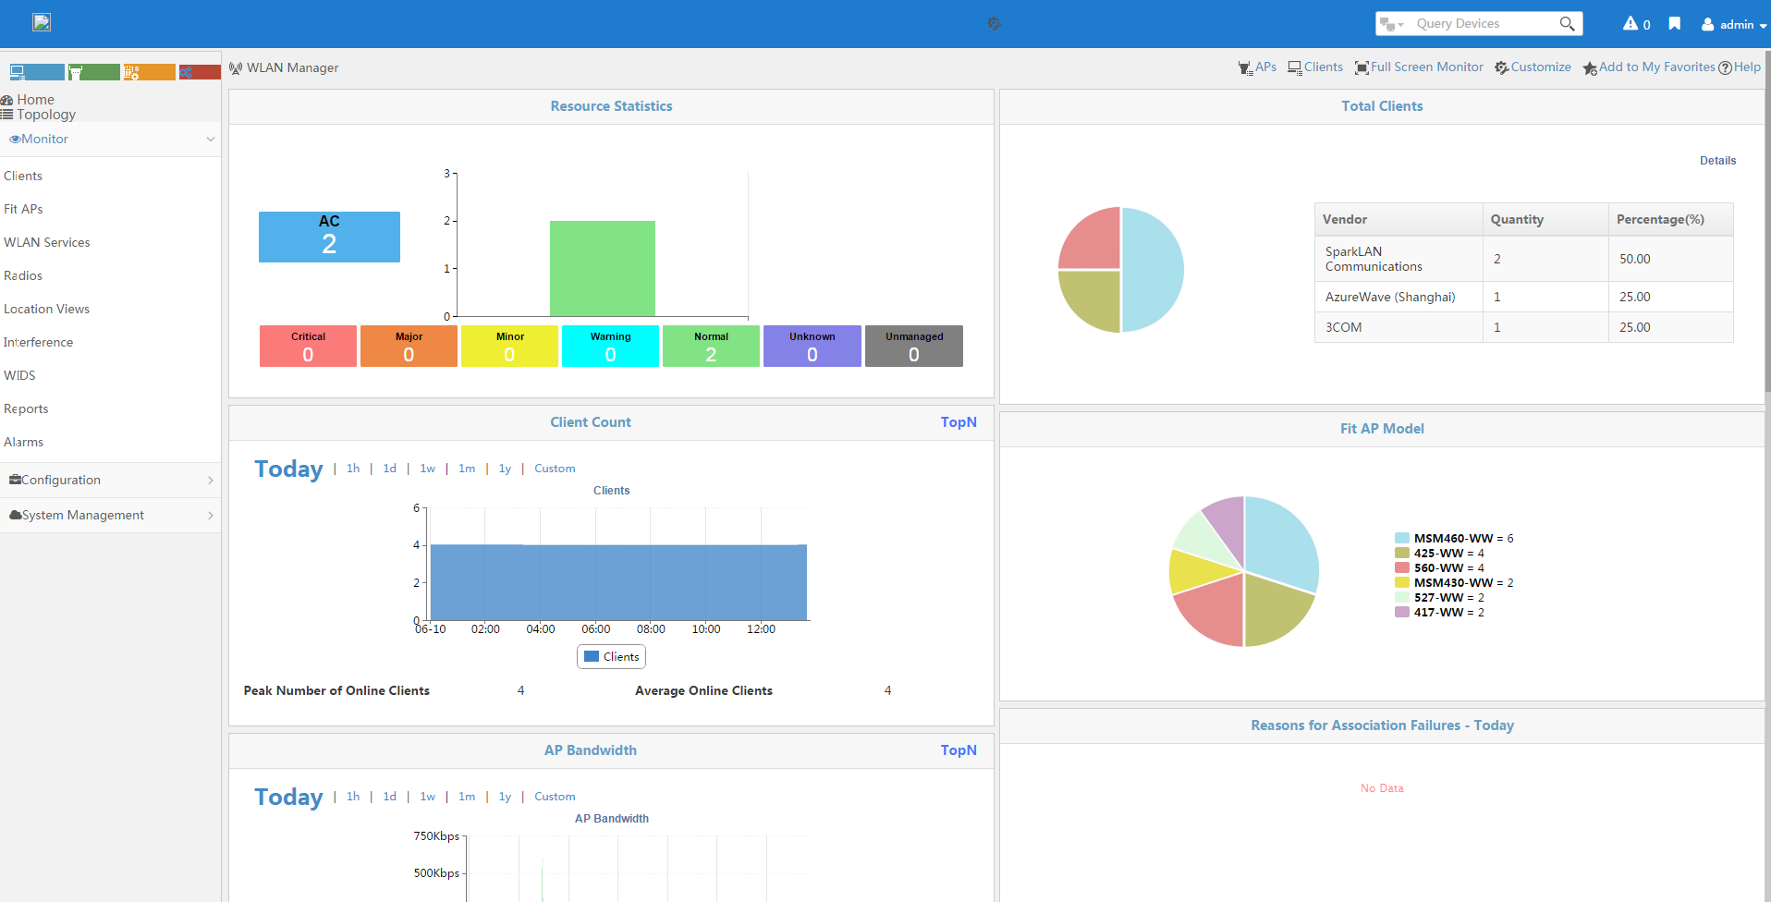
Customizing UI
Perspective UI (Not Yet available)
New UI « context aware »
UI depends on the iMC section
All in one window
Basic Platform Perspective
WLAN Perspective

Slide 18
AGENDA
Customizing UI (customization for Dummies)
Home Page - Favorites
Custom Topologies
Dashboard and Display Tilling
Customize alarm management and actions (basic customization)
SNMP traps / Syslog messages
Automatic Actions
Adding new device SNMP support and monitoring (advanced customization)
New device model
New performance monitoring
New device panel
Add configuration management and actions (expert customization)
Configuration management
New action
New batch operations
Add report templates (guru customization)
Using iAR
Importing the template
Integrate with third application (super guru customization)
eAPI documentation
eAPI example
Notes:
If time, show the event correlation (root cause)

Slide 19
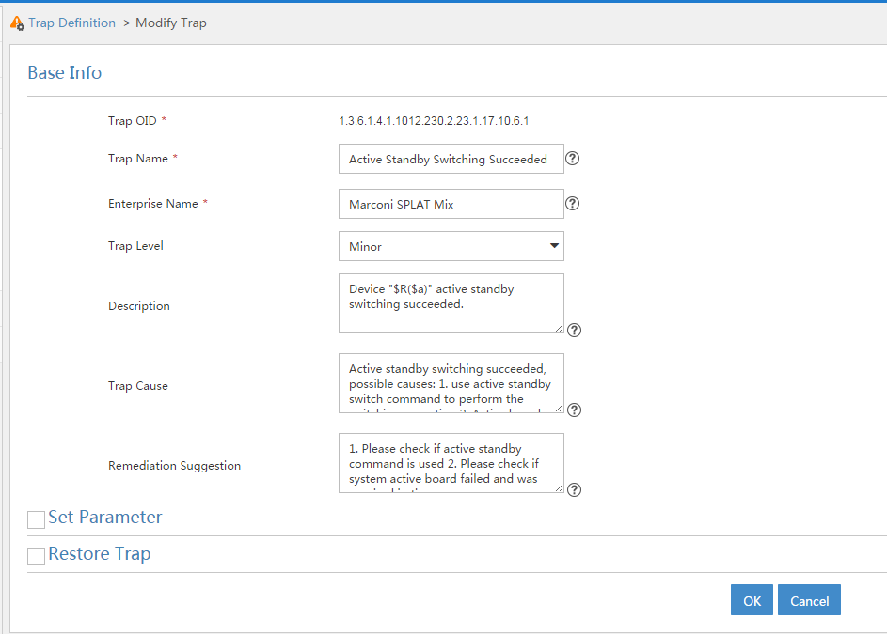
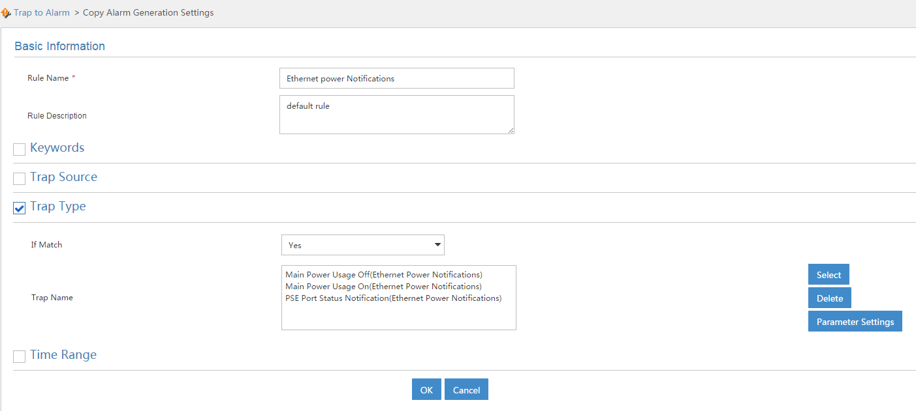
Customizing Alarm Management and Actions
SNMP traps
Can manually add trap definition (with specific severity, keywords …)
And then choose which one to transform into alarms (and when, for which source …)

Slide 20

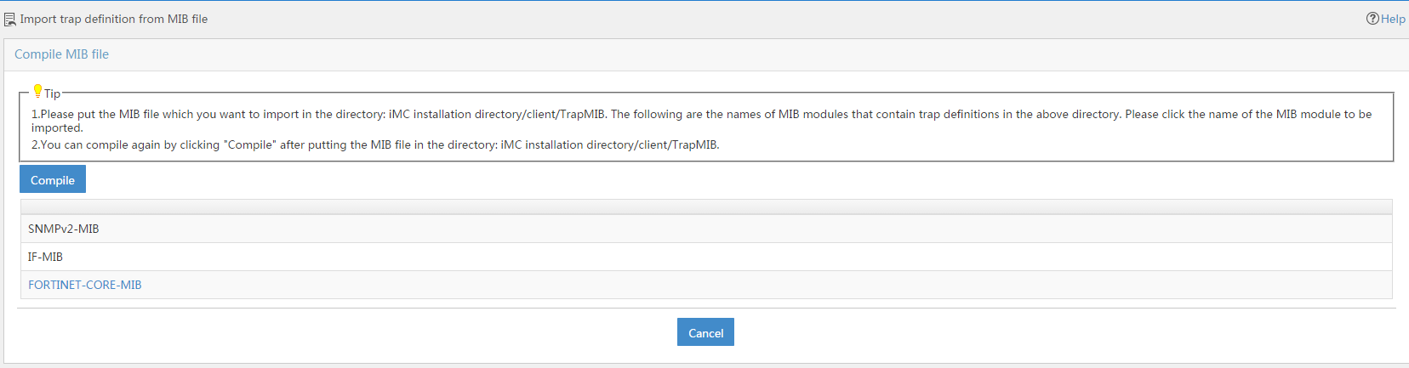
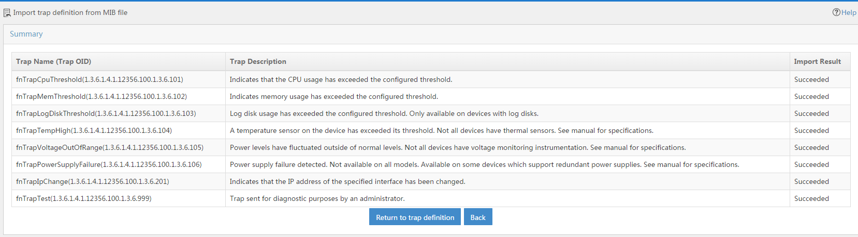
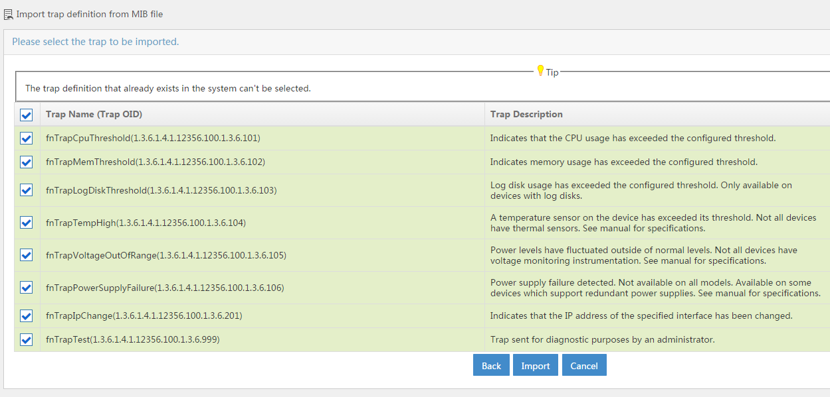
Customizing Alarm Management and Actions
SNMP traps
Also possible to import traps from MIB file (for example FORTINET ones here) using the button: (After having put the file in directory “iMC installation directory/client/TrapMIB”) Mandatory to add in a second step Trap to Alarm definition (not automatic when importing MIB files)

Slide 21
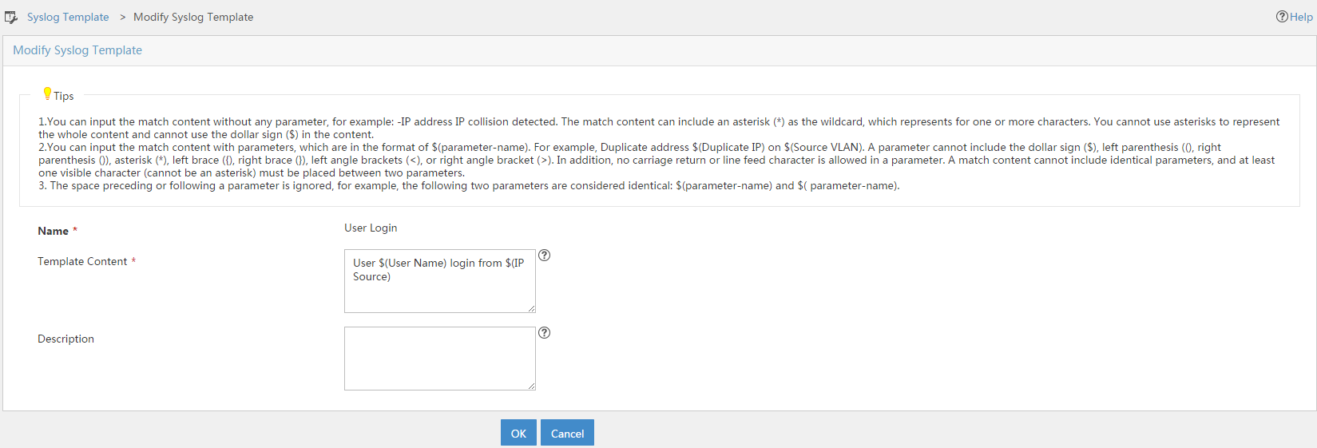
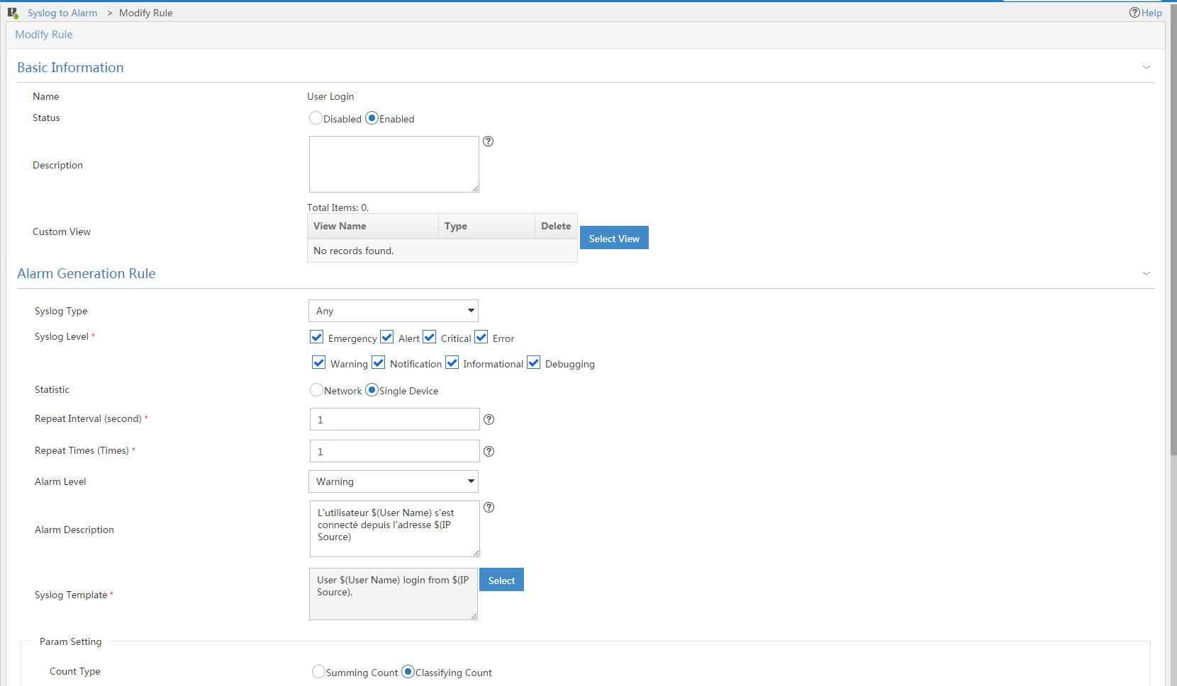
Customizing Alarm Management and Actions
Syslog Messages
Use syslog templates (with pattern matching) to identify messages to catch (and define some parameters)
Use « Syslog to Alarm » to identify messages to display in the alarm browser (and translate it in an understandable way, using parameters defined before)

Slide 22
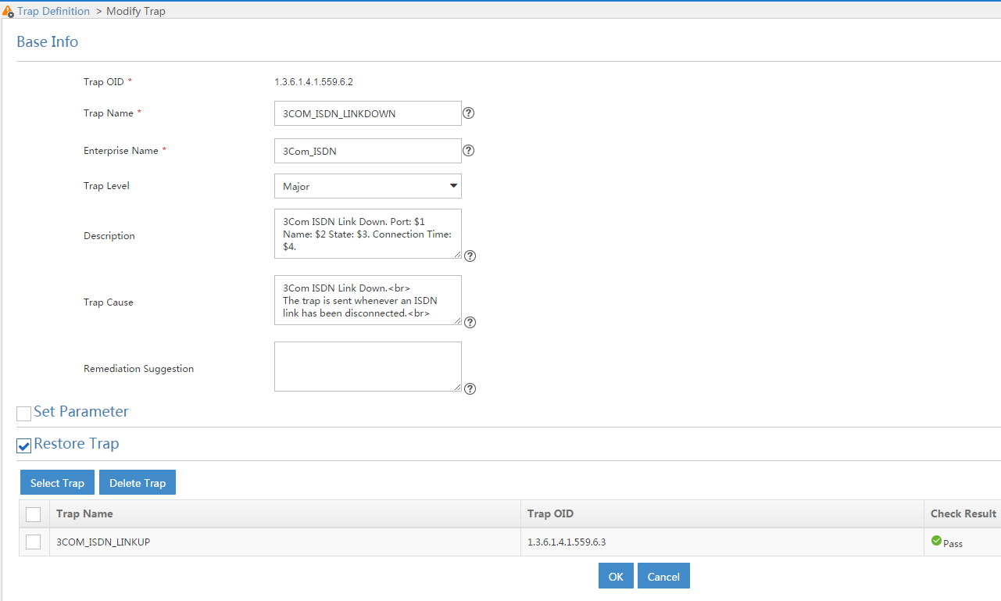
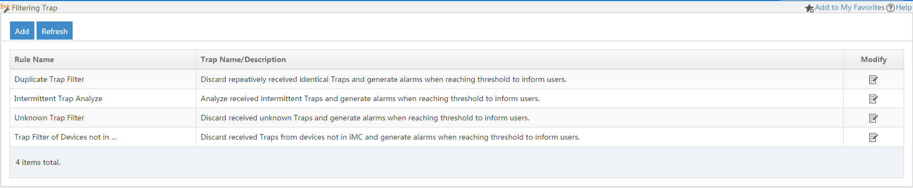
Customizing Alarm Management and Actions
Correlation
Recover Alarm: in the alarm definition itself
Deduplication / Intermittent / Unknown … : in the filtering trap menu

Slide 23
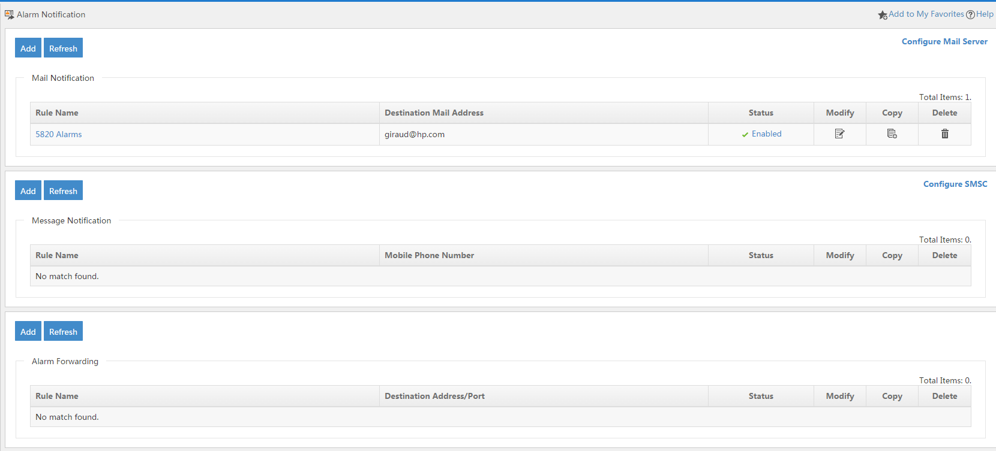
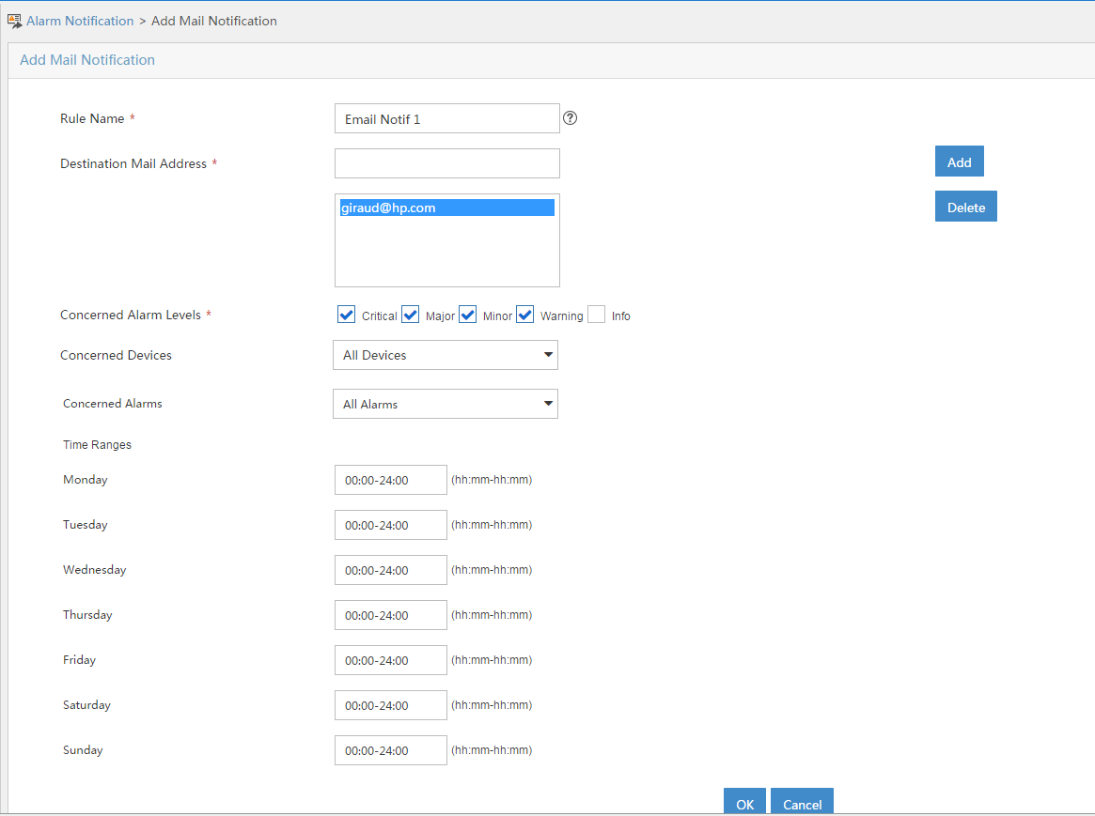
Customizing Alarm Management and Actions
Automatic Action – Simple forwarding
In the « Alarm Notification » : forward by email, SMS or SNMP Trap forwarding

Slide 24
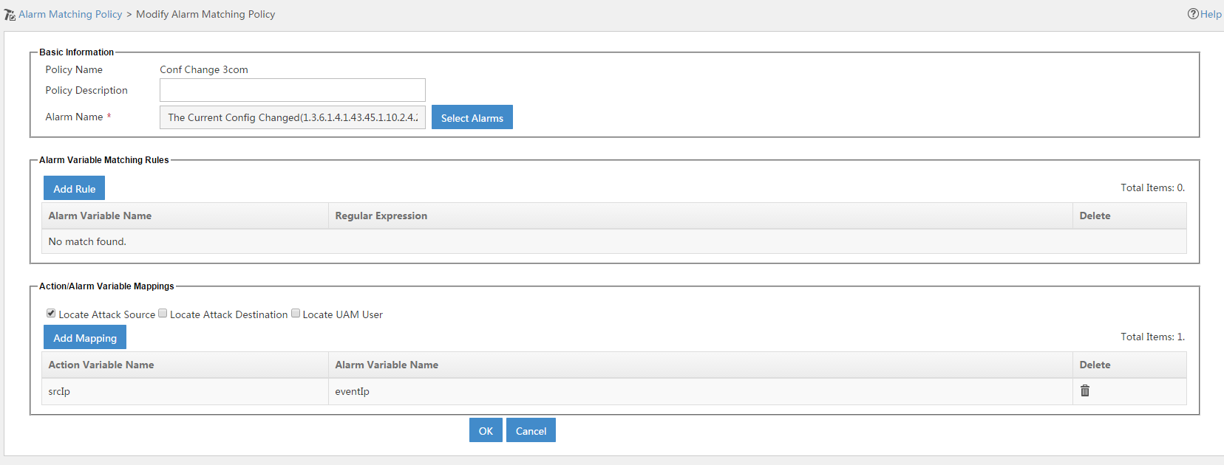
Customizing Alarm Management and Actions
Automatic Action – More complex rules
Uses the Security Control Center first to identify the alarm on which to take automatic action → Alarm Matching Policy

Slide 25
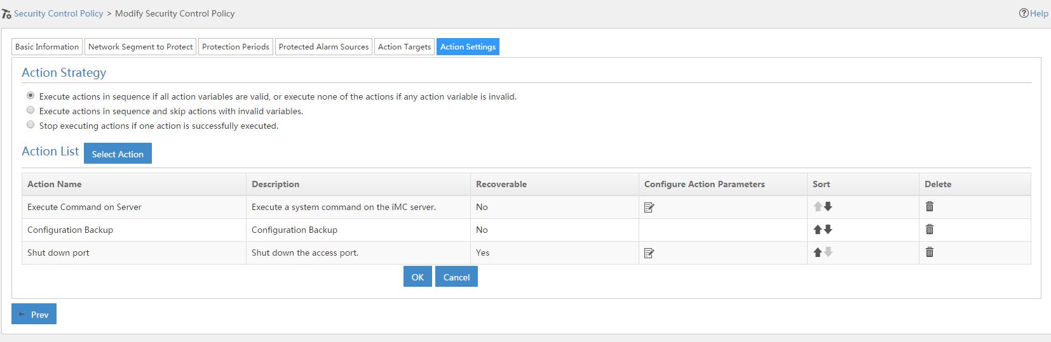
Customizing Alarm Management and Actions
Automatic Action – More complex rules (Cont)
Second step in the Security Control Center: specify the actions to take (and when, on which object …) → Security Control Policy

Slide 26
Customizing Alarm Management and Actions
Intelligent Policy Center (NEW !)
Used to automate some flow of Actions / Configurations based on Network events or user created event (periodically for example)
Periodic
Parameter Filter
If-else work flow
Map container
Work scope
Multi-actions in one policy
Return value injection
Open registration Customized page
Policy Center
Events
Sent
Engine
Trigger
Actions
Recognize & match by policy
Policies

Slide 27
Customizing Alarm Management and Actions
Intelligent Policy Center (NEW !)
Example: Periodic change of SSID passphrase
Send email
Generate Password
Deploy SSID Password
admin
Policy Center
AC
AP
AP
AP
Change Password every Sunday night

Slide 28
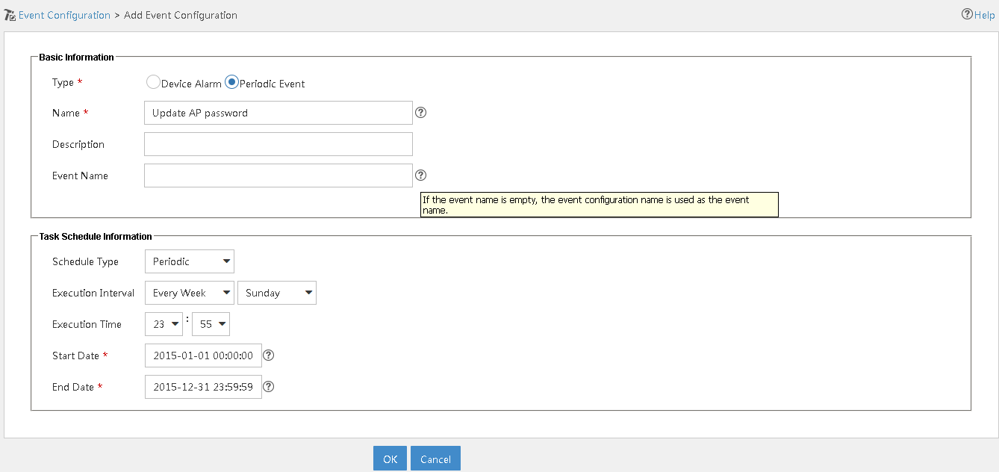
Customizing Alarm Management and Actions
Intelligent Policy Center (NEW !)
Example: Periodic change of SSID passphrase – Step 1 : Periodic event

Slide 29
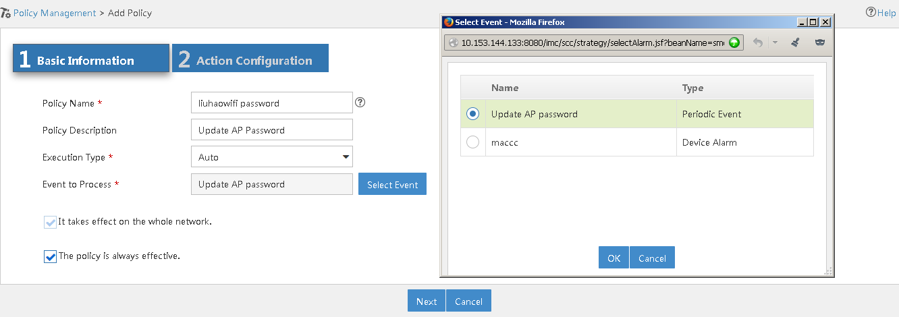
Customizing Alarm Management and Actions
Intelligent Policy Center (NEW !)
Example: Periodic change of SSID passphrase – Step 2 : Policy Management – Basic info

Slide 30
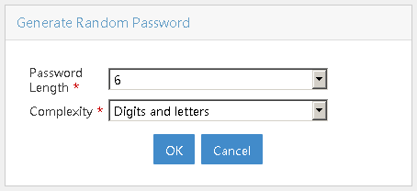
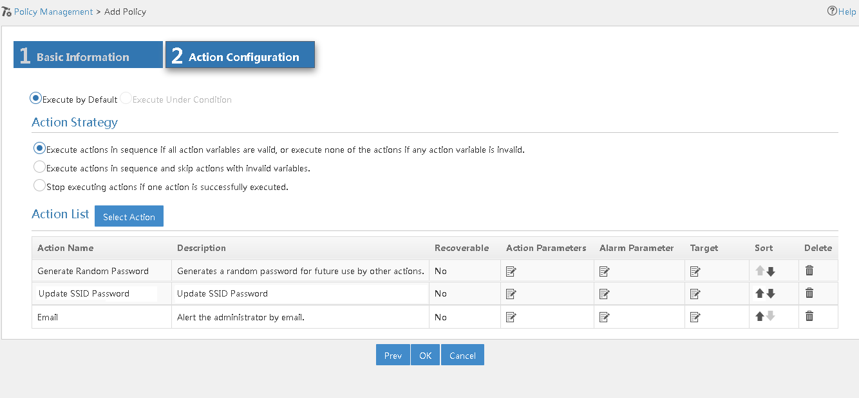
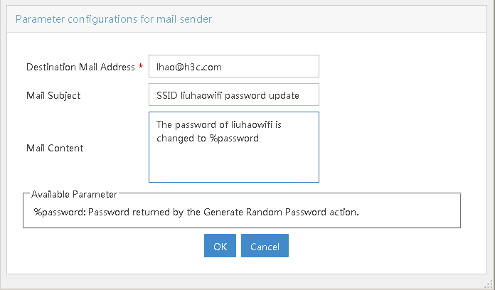
Customizing Alarm Management and Actions
Intelligent Policy Center (NEW !)
Example: Periodic change of SSID passphrase – Step 3 : Policy Management – Action Flow

Slide 31
AGENDA
Customizing UI (customization for Dummies)
Home Page - Favorites
Custom Topologies
Dashboard and Display Tilling
Customize alarm management and Actions (basic customization)
SNMP traps / Syslog messages
Automatic Actions
Adding new device SNMP support and monitoring (advanced customization)
New device model
New performance monitoring
New device panel
Add configuration management and actions (expert customization)
Configuration management
New action
New batch operations
Add report templates (guru customization)
Using iAR
Importing the template
Integrate with third application (super guru customization)
eAPI documentation
eAPI example
Notes:
If time, show the event correlation (root cause)

Slide 32
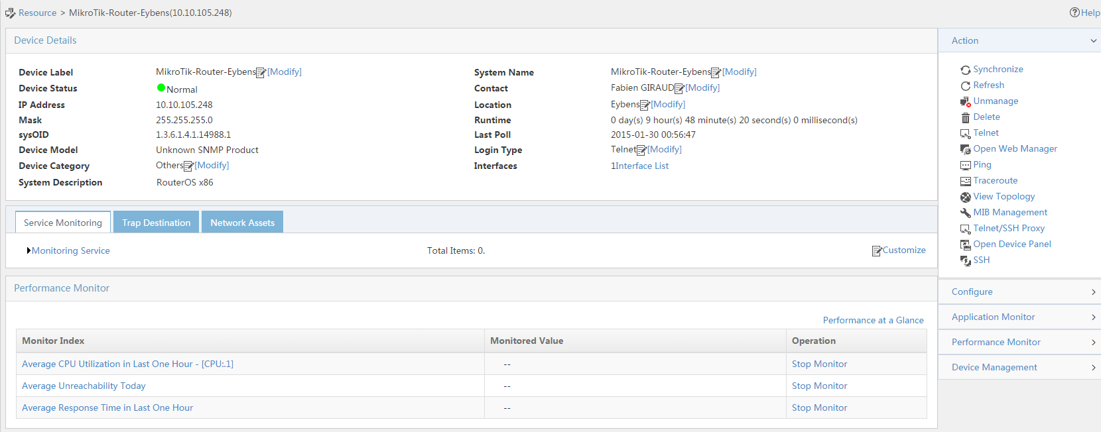
Adding new device SNMP support and monitoring
New device model
New kind of device added on the network → appears as « unknown ». This device is a Virtual Router from MikroTik company

Slide 33
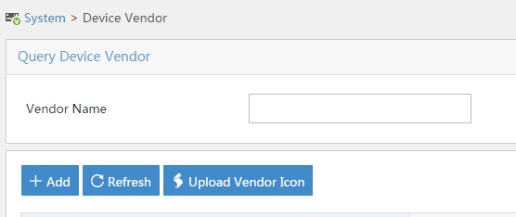
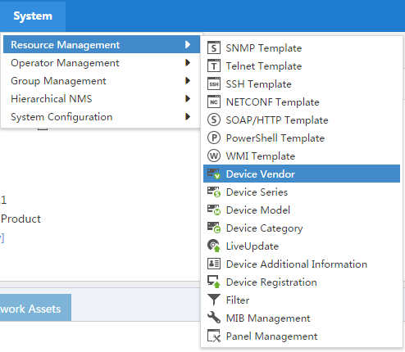
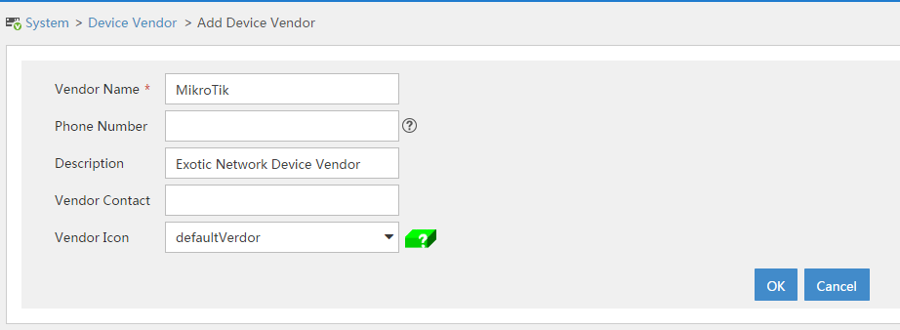
Adding new device SNMP support and monitoring
New device model
4 steps: Add the device Vendor, the device type, device serie and the device model
Step1: Add the Vendor
Possible to upload our own icons

Slide 34
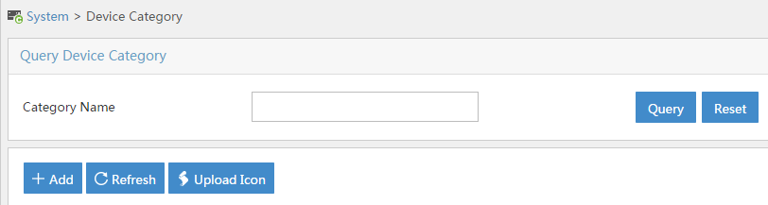
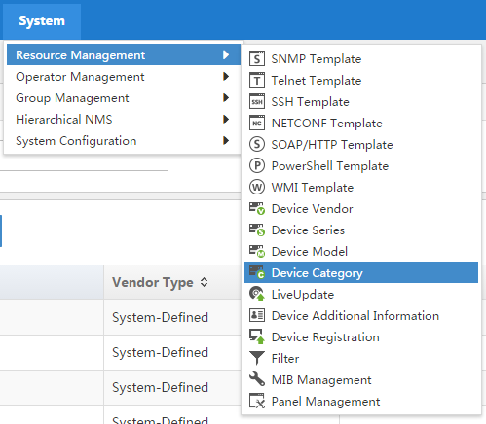
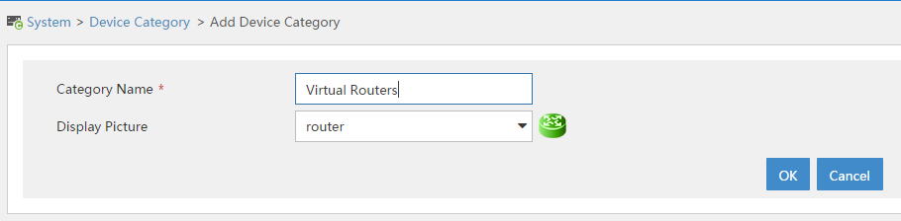
Adding new device SNMP support and monitoring
New device model
Step2: Add the Device Type

Slide 35
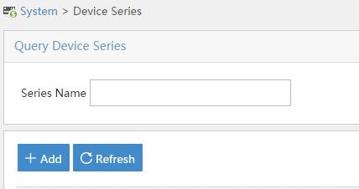
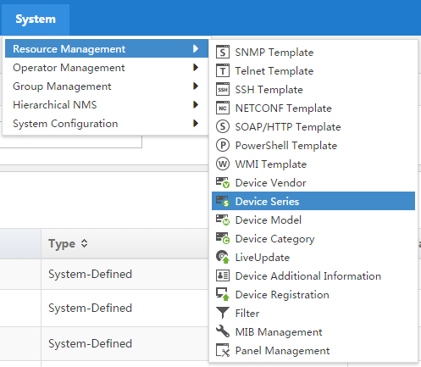
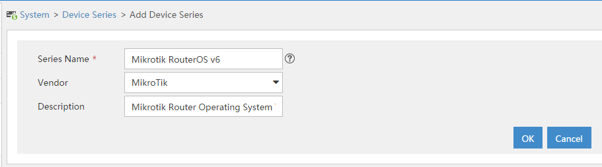
Adding new device SNMP support and monitoring
New device model
Step3: Add the Serie

Slide 36
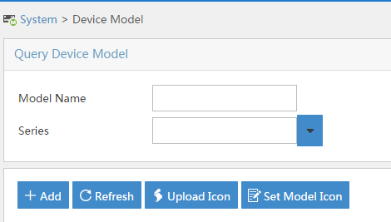
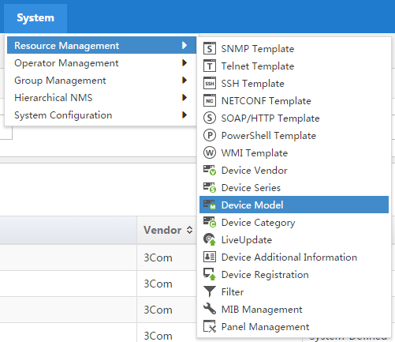
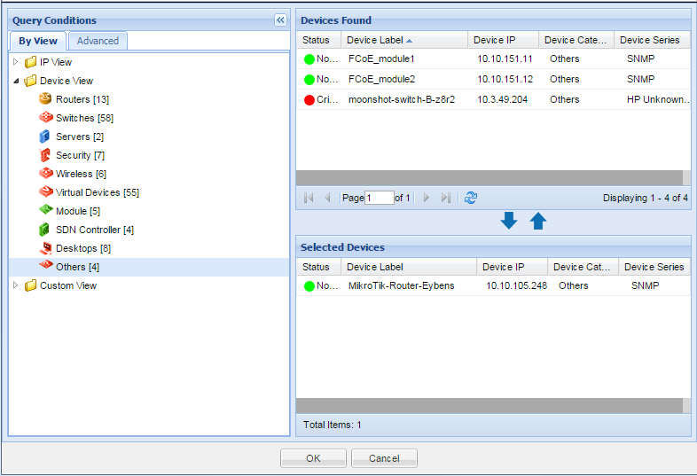


Adding new device SNMP support and monitoring
New device model
Step4: Add the Model and associate to the devices using the SysOID
We can manually add the SysOID (if we are so clever that we already know it),
or (USEFULL) we can query this on a selected device !

Slide 37

Adding new device SNMP support and monitoring
New device model
Let’s synchronize the new device (if it is not already done)

Slide 38






Adding new device SNMP support and monitoring
New Performance Monitoring
First, we can import Mib file for this kind of device (and so then use it for perf monitoring)
1: Compile the MIB file
2: Load the MIB

Slide 39




Adding new device SNMP support and monitoring
New Performance Monitoring
Now we can add some new indexes / formula to monitor
We can manually add SysOID or select it in the MIB Browser
Also possible to define thresholds for automatic Alarming

Slide 40




Adding new device SNMP support and monitoring
New Performance Monitoring
New index can be used for real time monitoring and/or also for historical stats in Performance Views
Real Time
Historical

Slide 41



Adding new device SNMP support and monitoring
New Performance Monitoring
And create a performance view with this monitored index

Slide 42


Adding new device SNMP support and monitoring
New Performance Monitoring
Performance View → result

Slide 43



Adding new device SNMP support and monitoring
New Performance Monitoring
Also: new index can be displayed directly on the maps (via menu Dta Shown in Topo)
Result

Slide 44

Adding new device SNMP support and monitoring
New Device Panel
Out-of-the-box : default picture:

Slide 45

Adding new device SNMP support and monitoring
New Device Panel - Design
Use the Visual Panel Designer (available in the tools directory of iMC binaries)
1: Add a chassis
2: Fill in the SysOID
4: Choose SNMP data to monitor status
3: Upload a picture
4: Drag and drop the chassis in the drawing area
5: Add some ports, fan … one by one or in batch

Slide 46



Adding new device SNMP support and monitoring
New Device Panel – Import in iMC
First export the project in a zip file using menu Project → Export Project
Import it in iMC (System → Ressource Management → Panel Management)

Slide 47


Adding new device SNMP support and monitoring
New Device Panel - Result
Open again the Device Panel:

Slide 48
AGENDA
Customizing UI (customization for Dummies)
Home Page - Favorites
Custom Topologies
Dashboard and Display Tilling
Customize alarm management and Actions (basic customization)
SNMP traps / Syslog messages
Automatic Actions
Adding new device SNMP support and monitoring (advanced customization)
New device model
New performance monitoring
New device panel
Add configuration management and actions (expert customization)
Configuration management
New action
New batch operations
Add report templates (guru customization)
Using iAR
Importing the template
Integrate with third application (super guru customization)
eAPI documentation
eAPI example
Notes:
If time, show the event correlation (root cause)

Slide 49


Add configuration management and actions
Configuration Management – Current situation
Configuration backup does not work

Slide 50


Add configuration management and actions
Configuration Management – Step 1
To add new configuration management support: needs to modify some xml definition files and add some tcl scripts in directory <iMC install Dir>/ server/conf/adapters/ICC (and put these scripts eventually in a new folder) (can do same kind of dev for VLAN management in vlandm directory)
First step is to create the new directory (if needed) and associate the device type (using SysOID) with the new adapter we will create in adapter-index.xml
<?xml version="1.0"?>
<!--sysoid adapt adapter-->
<adapters>
<type name="CLI">
<adapter name="RouterOS6">
<description>Mikrotik demo adapter for RouterOS v6 and Higher</description>
<sysoid>1.3.6.1.4.1.14988.1</sysoid>
</adapter>
</type>
</adapters>

Slide 51


Add configuration management and actions
Configuration Management – Step 2
Second step: add the corresponding directory (with exactly the same name as the Adapter Name field) and create file adapter.xml to reference the different methods to use
CLICommon is used to enter different CLI modes (exec, configuration …)
ConfigBackup will give the command to backup the conf on the device
CleanupParser is used to clean the output of the configuration display command for example (removing prompt …)
<adapter name="RouterOS6">
<version>1.0.0</version>
<services>
<service name="CLICommon">
<item type="common">Mikrotik_Common_CLI.xml</item>
</service>
<service name="ConfigBackup">
<item type="builder_definition">Mikrotik_Config_Backup_Builder.xml</item>
<item type="tcl_script">Mikrotik_Config_Backup_Builder_Script.xml</item>
</service>
<service name="CleanupParser">
<item type="parser_definition">Mikrotik_Cleanup_Parser.xml</item>
<item type="perl_script">Mikrotik_Cleanup_Parser_Script.pl</item>
</service>
</services>
</adapter>

Slide 52

Add configuration management and actions
Configuration Management – Step 3
Third step: define the function (initialization, backup, cleanup …) using tcl scripts and xml files
Initializing connection: Mikrotik_Common_Cli.xml, initialize.tcl, enter_exec.tcl and exit_exec.tcl
<?xml version="1.0"?>
<common>
<mode name="initialize" method="cli">
<require-mode>connect</require-mode>
<enter>
initialize.tcl
</enter>
</mode>
<mode name="exec" method="cli">
<error>Failed to get to exec mode. </error>
<require-mode>initialize</require-mode>
<enter>
enter_exec.tcl
</enter>
<exit>
exit_exec.tcl
</exit>
</mode>
</common>
set IGNORE_DELAY true
set loop true
set timeout $standard_timeout
while {$loop == "true"} {
expect {
$password_prompt {
send "$password"
sleep 1
send "\r"
} $username_prompt {
send "$username"
sleep 1
send "\r"
} $login_as {
send "$username"
sleep 1
send "\r"
} $info_prompt {
send "\r"
} "Store key in cache" {
send "y\r"
set loop false
} -re $exec_prompt {
set loop false
} "incorrect username or password" {
set ERROR_MESSAGE "Authentication failed"
set ERROR_RESULT true
return
} "Access denied" {
set ERROR_MESSAGE "Authentication failed"
set ERROR_RESULT true
return
}
}
}
set IGNORE_DELAY false
set standard_timeout 10
set long_timeout 120
set very_long_timeout 1800
set username_prompt ogin:
set password_prompt assword:
set login_as "ogin as:"
set info_prompt "continue!"
set exec_prompt "] >"
set timeout $standard_timeout
set ERROR_RESULT false
set ERROR_MESSAGE ""
send "quit\r"

Slide 53

Add configuration management and actions
Configuration Management – Step 3 (cont)
Now: backup script and parser (since we’ll do the backup using CLI ouput and not tftp or scp): Mikrotik_Config_Backup_Builder.xml, Mikrotik_Config_Backup_Builder_Script.xml, backup_startup_config_cli.tcl, Mikrotik_Cleanup_Parser.xml and Mikrotik_Cleanup_Parser_Script.pl
<?xml version="1.0"?>
<definition>
<action name="backup_startup_config">
<step>
<command name="backup_startup_config_cli" description="Backup startup via CLI">
<result name="startup_configuration">
<parser parserName="CleanupParser" parserRet="configuration" parserScript="cleanupConfiguration"/>
</result>
</command>
</step>
</action>
</definition>
<?xml version="1.0"?>
<scripts>
<command name="backup_startup_config_cli" method="CLI">
<error>Failed to backup configuration</error>
<require-mode>exec</require-mode>
<script>
backup_startup_config_cli.tcl
</script>
</command>
</scripts>
set timeout $standard_timeout
sleep 1
expect -re $exec_prompt {
}
send "export\r"
expect -re #
expect -re $exec_prompt {
}
#! /usr/local/bin/perl
sub cleanupConfiguration
{
my($config) = @_;
# CLI sometimes leaks in some syslog messages.. remove them _first_ [important]
# $config =~ s/(^|\n)\%.*//g;
$start = index($config, "\# software id = ");
if ($start == -1)
{
$start = 0;
}
$cleanConfig = substr($config, $start);
# Get rid of the exec prompt at the end, and any blank lines
$cleanConfig =~ s/\[.*\] \>.*/\n/;
$cleanConfig =~ s/\n+$//;
# Add a trailing newline to match file transfer results
$cleanConfig = $cleanConfig . "\n";
return $cleanConfig;
}
<?xml version="1.0"?>
<parser>
<perlfile>Mikrotik_Cleanup_Parser_Script.pl</perlfile>
<script name="cleanupConfiguration">
<callfunction name="cleanupConfiguration">
<parameterspec name="0" type="data_string"/>
<result type="single">configuration</result>
</callfunction>
</script>
</parser>

Slide 54

Add configuration management and actions
Configuration Management – Step 4
Last step: in order to apply changes, we can restart iMC server, or (simpler) restart only process imccfgbakdm

Slide 55


Add configuration management and actions
Configuration Management – Result
Backup running does not work since this concept does not really exist on this device (and so we didn’t implement it)

Slide 56



Add configuration management and actions
New Action – Current situation
Some available actions & tools:

Slide 57
Add configuration management and actions
New Action
Two kind of customizable actions:
Executables
URL
Can use arguments such as IP address of the selected device, credentials, SNMP community …
Configuration files are located in <iMC install Dir>/client/web/apps/imc/WEB-INF/
Can use custom icon in:
<iMC install Dir>/client/web/apps/imc/resources/images/blue/res/
<iMC install Dir>/client/web/apps/imc/resources/images/lightgray/res/
<iMC install Dir>/client/web/apps/imc/resources/images/classic/res/
<iMC install Dir>/client/web/apps/imc/resources/images/white/res/
If executable is not present on the client, possible to make it available for download from iMC (need to be available in directory <iMC install Dir>/client/web/apps/imc/plat/exec/

Slide 58



Add configuration management and actions
New Action – Exe on client
Let’s get zenmap as an example. We’ll make it available for all devices (so we use SNMP SysOID wildcard *)
We’ll use icon: and installer downloaded from www.nmap.org (nmap-6.47-setup.exe)
<?xml version="1.0" encoding="UTF-8"?>
<tools-config xmlns="http://www.h3c.com/device-tools-config" xmlns:xsi="http://www.w3.org/2001/XMLSchema-instance" xsi:schemaLocation="http://www.h3c.com/device-tools-config dev-tools-config_1_0.xsd ">
<description>Zenmap network scan tool configuration</description>
<resource-bundle>com.h3c.imc.plat.LocalStrings</resource-bundle>
<config id="zenmap">
<conditions>
<sys-oid>
<wildcard-matcher>*</wildcard-matcher>
</sys-oid>
</conditions>
<action>
<client-tool>
<app.name>Zenmap scan</app.name>
<img.url>res/zenmap.png</img.url>
<pref.defpath>C:\Program Files (x86)\Nmap\zenmap.exe</pref.defpath>
<pref.pathkey>com.h3c.imc.plat.exec.zenmap</pref.pathkey>
<download.url>nmap-6.47-setup.exe</download.url>
<app.arg>-t ${DEVICE_IP}</app.arg>
</client-tool>
</action>
</config>
</tools-config>

Slide 59

Add configuration management and actions
New Action - URL
For MikroTik router devices we want to open the documentation web page: http://wiki.mikrotik.com/wiki/Manual:TOC
<?xml version="1.0" encoding="UTF-8"?>
<tools-config xmlns="http://www.h3c.com/device-tools-config" xmlns:xsi="http://www.w3.org/2001/XMLSchema-instance" xsi:schemaLocation="http://www.h3c.com/device-tools-config dev-tools-config_1_0.xsd ">
<description>MikroTik Router Doc</description>
<resource-bundle>com.h3c.imc.plat.LocalStrings</resource-bundle>
<config id="MikroTikManual">
<conditions>
<sys-oid use-when-no-sysoid="false">
<value>1.3.6.1.4.1.14988.1</value>
</sys-oid>
</conditions>
<action>
<url>
<url.name>Download manuals</url.name>
<img.url>res/icon_dev_reg_16x16.png</img.url>
<url.value>http://wiki.mikrotik.com/wiki/Manual:TOC</url.value>
<param name="sp4ts.oid" value="5443163"/>
</url>
</action>
</config>
</tools-config>
MikroTik router SysOID

Slide 60

Add configuration management and actions
New Action – Apply changes
In order the changes to take effect, need to restart JServer

Slide 61





Add configuration management and actions
New Action – Result: Exec

Slide 62


Add configuration management and actions
New Action – Result URL
For MikroTik Routers:

Slide 63

Add configuration management and actions
New Batch Operations
In iMC: possible to execute operations in batch:

Slide 64
Add configuration management and actions
New Batch Operations
Advantages of custom batch operations compared to custom conf templates:
GUI wizard to enter parameters of your choice with variety of GUI options such as check box, check box group, input box, combo box or even calendar tool
GUI components can be populated statically or even dynamically load values (via TCL scripts directly from device or via iMC REST API) – for example your wizard can list currently configured items such as VLANs, ACLs, …
Scripting implementation allows for very complex scenarios including checks, parsing and editing existing configurations (for example remove configured items with undo/no statements)
Implementation can leverage iMC REST APIs for your tasks
Operations have defined dependencies on devices capabilities and GUI is parsing those accordingly, so you can only select devices that your operation actually supports

Slide 65

Add configuration management and actions
New Batch Operations
First: create directory <imc install dir>/client/web/apps/imc/gencfg/register/custom
In this directory, we’ll use 3 files:
custom_devCapabilities.xml (use to filter only applicable devices for our custom operation)
custom_operations.xml (definition of the operations themselves and parameters)
custom.properties (empty here, since we harcoded the properties in the operation file)
Need to restart jserver at the end
<?xml version="1.0" encoding="UTF-8"?>
<Operations>
<Operation id="ComwareNTP" label="Configure NTP" categoryId="custom" devCapability="ComwareNTP" actionId="ComwareNTPaction" actionType="2" operLevel="1">
<Asn1Action id="ComwareNTPaction" serviceName="ComwareNTP" actionName="ComwareNTPaction" operType="1" operMode="2" execMode="1">
<Parameter name="Authentication" label="Enable MD5 authentication" dataType="boolean" required="true">
<View type="Checkbox"/>
</Parameter>
<Parameter name="keyid" label="Authentication key ID" validateRegEx="[0-9]*" required="false">
<View type="InputText"/>
</Parameter>
<Parameter name="key" label="Authentication key" required="false">
<View type="InputText"/>
</Parameter>
<Parameter name="server" label="NTP server IP" validateRegEx="[0-9]{1,3}.[0-9]{1,3}.[0-9]{1,3}.[0-9]{1,3}" required="true">
<View type="InputText"/>
</Parameter>
<Parameter name="Commit" label="Commit to flash" dataType="boolean" required="true">
<View type="Checkbox"/>
</Parameter>
</Asn1Action>
</Operation>
</Operations>
<?xml version="1.0" encoding="UTF-8"?>
<DevCapabilities>
<Capability name="ComwareNTP">
<Sysoid>1.3.6.1.4.1.25506</Sysoid>
</Capability>
</DevCapabilities>

Slide 66
Add configuration management and actions
New Batch Operations
GUI now ok: we now need to implement actual adapters.
Folder: <imc install dir>/server/conf/adapters/GenericConfig/ (in our example /H3C/H3CCommonCLI/adapter.xml)
In this directory, we’ll use 4 files:
adapter.xml to reference the different methods to use (make sure to define same service as in the GUI customization just before : ComwareNTP)
H3CCommonCLI_NTP_Builder.xml (builder definition)
H3CCommonCLI_NTP_Builder_Script.xml (Commands definition)
setup_ntp.tcl (actual script file)
Need to restart imc process: imccmdmgrdm at the end

Slide 67

Add configuration management and actions
New Batch Operations
<service name="ComwareNTP">
<item type="builder_definition">H3CCommonCLI_NTP_Builder.xml</item>
<item type="tcl_script">H3CCommonCLI_NTP_Builder_Script.xml</item>
</service>
expect -re $enable_prompt
send "ntp-service enable\r"
expect -re $enable_prompt
if {$Authentication} {
send "ntp-service authentication enable\r"
expect -re $enable_prompt
send "ntp-service authentication-keyid $keyid authentication-mode md5 simple $key\r"
expect -re $enable_prompt
send "ntp-service reliable authentication-keyid $keyid\r"
expect -re $enable_prompt
send "ntp-service unicast-server $server authentication-keyid $keyid\r"
} else {
send "ntp-service unicast-server $server\r"
}
expect -re $enable_prompt
if {$Commit} {
send "save force\r"
}
expect -re $enable_prompt
<?xml version="1.0"?>
<definition>
<action name="ComwareNTPaction">
<step>
<command name="setup_ntp" description="configure ntp">
</command>
</step>
</action>
</definition>
<?xml version="1.0"?>
<scripts>
<command name="setup_ntp" method="CLI">
<error>Failed to setup ntp.</error>
<require-mode>enable</require-mode>
<script>
setup_ntp.tcl
</script>
</command>
</scripts>

Slide 68






Add configuration management and actions
New Batch Operations - Result

Slide 69
AGENDA
Customizing UI (customization for Dummies)
Home Page - Favorites
Custom Topologies
Dashboard and Display Tilling
Customize alarm management and Actions (basic customization)
SNMP traps / Syslog messages
Automatic Actions
Adding new device SNMP support and monitoring (advanced customization)
New device model
New performance monitoring
New device panel
Add configuration management and actions (expert customization)
Configuration management
New action
New batch operations
Add report templates (guru customization)
Using iAR
Importing the template
Integrate with third application (super guru customization)
eAPI documentation
eAPI example
Notes:
If time, show the event correlation (root cause)

Slide 70
Add Report Template
iAR
To add custom report template: needs iAR module
iAR is a module based on Crystal Report
Can be installed on any computer which has access to iMC database server
Allow to connect directly to the iMC database and so get exactly the info needed (eventually with some calculation, formatting, parsing …)

Slide 71





Add Report Template
iAR – Quick start
After having launched iAR: needs to connect to the DB and select the tables we’ll need
…

Slide 72


Add Report Template
iAR – Quick start
Two part in iAR:
Design: used to built the report (put the info where we want, some pictures, background …)
Preview (shows the result in live connecting to the DB)
Preview
Design

Slide 73


Add Report Template
iAR – Quick Start
Can use formula for data to display and also for formatting rules
Formating Formula
Formula Field

Slide 74




Add Report Template
Importing in iMC
After having saved the report template, we can import it in iMC
We can also import an xml configuration file in order to link some parameters in the template to some internal iMC variables

Slide 75



Add Report Template
Result

Slide 76
Add Report Template
More
To see more detailed instruction (and an example):

Slide 77


Add Report Template
Bonus : iAR V2 (Available soon)
New iAR will be based on JasperSoft instead of CrystalReport
Preview

Slide 78
AGENDA
Customizing UI (customization for Dummies)
Home Page - Favorites
Custom Topologies
Dashboard and Display Tilling
Customize alarm management and Actions (basic customization)
SNMP traps / Syslog messages
Automatic Actions
Adding new device SNMP support and monitoring (advanced customization)
New device model
New performance monitoring
New device panel
Add configuration management and actions (expert customization)
Configuration management
New action
New batch operations
Add report templates (guru customization)
Using iAR
Importing the template
Integrate with third application (super guru customization)
eAPI documentation
eAPI example
Notes:
If time, show the event correlation (root cause)

Slide 79
eAPI
Introduction
RESTful API is very easy to use from any programming language by using simple HTTP requests
Particular function is represented by its URI
Usual logic for HTTP methods is the following:
GET to read values
POST to write values
PUT to modify values
DELETE to delete values
Very often API calls accept input arguments to provide filtration, ordering, paging or grouping
Human readable data format is used in two forms supported (you can use either one based on your preference)
XML structure
JSON structure

Slide 80


eAPI live documentation
Online documentation
Accessible at http://myip:8080/imcrs
You can find API calls and try them right from this interface

Slide 81

eAPI live documentation
Online user Guide / Examples
Click User Guide to get code examples for popular platforms such as Apache web app, Android SDK or Python

Slide 82

eAPI
Example
This is History Access Log in GUI listing known clients, their positions, connecting device, VLAN, time, …

Slide 83

eAPI
Example
Let’s now gather the same data via eAPI
Locate proper API URI call
Note this example is just for reading data from iMC, so only GET method is available

Slide 84

eAPI
Example
You can learn what data model will be returned
Fields are usually self explanatory

Slide 85

eAPI
Example
Response content header defines what data structure you expect as output – XML or JSON
GET accepts argument listed here allowing you to search only for specific MAC, IP, list only terminals connect to particular switch or only specific VLAN
There is paging capability implemented, so you can limit size of response to gather data in multiple calls (for example request start=0 size=10 for first page, start=10 size=10 for next page etc.)
You can specify ordering field
Optionaly instead of records you can get just total number of matching entries

Slide 86

eAPI
Example
Live documentation will print actual response, here is XML example (some people prefer JSON for its better efficiency and easier implementation in some languages, but other people might be more familiar with XML)
As you can see you extract exactly the same information as GUI provides programmaticaly and use it in your project (some examples with follow)

Slide 87
eAPI
Interesting information to read
Real-time device location (where is you printer connected right now?)
Topology information (how switches are connected to each other?)
Alarms, syslog and traps
Device information and status
Interface data
VLAN distribution and memberships
Network assets (components, modules in devices, serial numbers, inventary numbers, audit information)
ACL used in devices
Read actual and historical device configurations
Read performance data

Slide 88
eAPI
Interesting data to write or modify
Add device and their accessibility settings (integrate with other systems)
Change VLAN and port configurations such as access port membership, description, up/down status
Create and apply ACLs
Create and apply device configuration templates
Modify performance threasholds

Slide 89
eAPI
Ideas you might consider
Integrate iMC with other management systems such as Asset management, legacy management system, …
Extract iMC data for use in other systems for security (for example correlate alarms with physical security and video surveilence), specific reporting (for example using performance and alarm data to provide daily health status emails for customers), archiving etc.
Use real-time location to quickly find where device is for example by wirelessly scanning QR code with MAC adress and providing ability to change VLAN, turn port off, read device configuration and use this to automate processes
Integrate iMC with your support procedures (for example your support call receiving system might be enhanced to poll iMC to display additional information such as user location, VLAN, port statistics, errors, etc.)
Automate iMC setup (for example people installing new devices in remote locations can enhance their tools to automatically publish information about new device to iMC including IP address, SNMP details etc.)
Leverage iMC abstractions to write high level scripts instead of dealing with differences between devices (for example you can write script to modify VLANs, port names or ACLs with no changes needed to support Comware, ProVision or Cisco)

Slide 90
eAPI – why stop here, eAPI is available with other iMC modules too !
WSM – extract value from wireless
Leverage real-time location engine to understand where your users are and use it for your business or security
Gather client information such associated AP, signal quality, used SSID etc. (for example you can specificaly poll network experience of your boss, calculate quality index and develop Android application that will be showing this)
Poll details about accesspoints such as data transferred per radio or SSID by last hour, alarm information etc.

Slide 91
eAPI – why stop here, eAPI is available with other iMC modules too !
UAM – automate for the best user experience
Register guests from application you already use (receptionist registration tool used for physical access, Outlook, reservation system, …)
Create users directly from your CRM system (for example as new user subscribes via your CRM application programatically create account in UAM and keep up to date)
Extract billing information from RADIUS accounting programatically
Read online users and their respective location (for example use for location aware advertisements)
Register new access devices without logging into iMC (for example your B2B portal can register new APs, gather information such as owner or physical location and also push shared secret and acess device configuration to UAM)

Slide 92
eAPI – why stop here, eAPI is available with other iMC modules too !
Other modules
Poll data from your SHM module to understand availability and SLA of your network in other business applications
Poll specific jitter test data including history from SHM supporting HP and Cisco
Use QoS Manager to deploy QoS profile on port (for example as engineer finished installation of new IPTV in your residential TripplePlay project you can create simple application that will provide MAC address of set-top-box and do real-time search and apply correct QoS on port)
… and more to come !

Slide 93
eAPI – Next STEP for you
In few Hours ☺
Please all attend the essential Networking Demo 10 – iMC API session
When: this afternoon (18/06/2015)
Where: Very close (Wicklow Hall 2A (100) - Demo Theatre 2)
Presenter: Chris YOUNG !!!

Slide 94

Please give us your feedback!

Slide 95
Thank you

